Slide 1
School Racial/Ethnic Composition and School Security
Tim Servoss
Canisius College
10/22/18
servosst@canisius.edu

Slide 2
Research Questions
Does school racial/ethnic composition predict overall levels of security at American middle and high schools?
If so, do these relationships hold when other school characteristics associated with school security are accounted for?
Does school racial/ethnic composition predict the presence and pattern of school security personnel at American middle and high schools?
If so, do these relationships hold when other school characteristics associated with school security are accounted for?
Notes:
In other words, are there inequities in the levels of security that students encounter that are based on the racial/ethnic characteristics of the students.
Many here have examined this. Most recent national data with slightly different conceptualizations of variables.

Slide 3
Data and Measures
2015-2016 School Survey on Crime and Safety (SSOCS)
Nationally representative sample of schools
About 1500 middle and high schools
School weights and jackknife replicate weights for variance estimation applied using AM
Overall Security
27 items tested for fit and scaled using dichotomous Rasch model
Final scale score based on 22 items
Underlying security construct accounts for 80% of the variance among the items
Racial/Ethnic composition
Percent of student body comprised of Black students
Percent of student body comprised of Hispanic students
Notes:
Has never made sense to me to consider security measures in isolation. Unmanned metal detectors that work on the honor system likely to be ineffective. Security cameras do not dismount from the wall and prevent crimes from occurring.
Rasch model weights less frequently occurring security measures more much like sometimes on an educational assessment you’ll get more credit for getting more difficult items correct.
Visitor sign-in and locking classroom doors vs. daily metal detector checks and school resource officer

Slide 4
Bivariate Results
Correlations
% Black and overall security (r = .187, p < .001)
% Hispanic and overall security (r = .091, p = .015)
ANOVA comparing means
No significant difference based on the % Hispanic population
Significant difference based on the %Black population
Notes:
Can I categorize schools based on how many hispanic and black kids there are and ANOVA to see if differences in overall security based on these groups

Slide 5
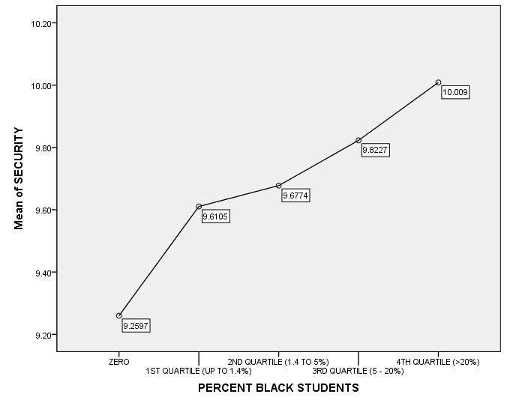
Bivariate Results-Means
d = .42
d = .89

Slide 6
Bivariate Results-Specific Measures
Comparing the schools with no Black students to those with the most
No difference | Significant difference | OR
School doors locked | Visitor sign-in | 7.12
Class doors lock | Grounds closed/locked gates | 2.76
Dog sniffs | Daily metal detector | ---
Sweeps for contraband | Random metal detector | 6.73
Drug testing | Uniforms | 7.73
Strict dress code | Student ID | 6.50
Presence of lockers | Faculty/Staff ID | 2.50
Silent alarm (panic button) | Two-way radios | 4.02
Clear book bags | Police/SRO | 5.04
Security cameras | Security Guards | 4.93
Electronic emergency notification
Anon. threat reporting system
Notes:
Daily metal OR unable to be calculated because there are no schools without blacks students that go through daily metal detector

Slide 7
Other characteristics
Urbanicity
Region of the US
SES (% students receiving free or reduced lunch)
Crime in neighborhood where school is located
Size (n of students enrolled)
Academics (% of students scoring < 15%-ile on standardized tests)
Misbehavior in the school
Racial/ethnic tension, bullying, harassment, widespread disorder in classrooms, verbal abuse of teachers, other acts of disrespect for teachers, gang activities
Crime in the school
Rape, sexual assault, robbery, physical attack, threats of physical attack, theft, weapons possession, distribution/possession of drugs/alcohol, vandalism
Notes:
Certainly other potential explanations to relationship between race and security
Harassment based sexual, gender identity, sexual orientation
Crimes: all with or without weapon, drugs both illegal and prescription

Slide 8
Multiple Regression results
Are %Black and %Hispanic students in the school still significant predictors of security even when adjusting for all of the characteristics listed on the previous slide?
Yes!, for %Black (β = .113, p = .017); for %Hispanic (β = .132, p = .005)
What else matters?
Region (Northeast and West, less than Midwest)
School size (more security in larger schools)
Crime (more security in schools with more crime)
Racial/ethnic composition is a slightly stronger predictor than crime
Adjusting for region and school size
Crime accounts for 2.5% of variance in security
Racial/ethnic composition accounts for 3.0% of variance in security
Notes:
Take two schools with same enrollment size, location, SES, general academic performance, misbehavior and crime in the school, the school with more black or hispanic students will have more security
Is student race the only thing that determines a school’s level of security? Of course not.

Slide 9
Racial/ethnic composition and security personnel
Categorized schools into one of 4 categories
No security personnel (23%)
Guards only (7%)
Police only (46%)
Both Guards and Police (24%)
Multinomial regression
DV = Guards vs None, Police vs None, Both vs None,
Predictors = urbanicity, region, SES, neighborhood crime, enrollment, % < 15th percentile, misbehavior and crime in the school, %black, %hispanic

Slide 10
Multinomial results (significant predictors)
Guard vs None | Police vs None | Both vs None
Urbanicity (Rural) |  | Urbanicity (Rural)
--City (3.59) |  | --City (2.40)
--Suburb (2.44) |  | --Suburb (2.03)
Region (Midwest) | Region (Midwest)
--Northeast (3.98) | --South (1.68)
 | --West (0.42)
Neighborhood crime (Low) | Neighborhood crime (Low) | Neighborhood crime (Low)
--Moderate (3.03) | --Moderate (1.67) | --Moderate(1.85)
Enrollment (1.27) | Enrollment (1.27) | Enrollment (1.45)
Crime in the school (low) | Crime in the school (low) | Crime in the school (low)
--Moderate (2.46) | --Moderate (1.88) | --Moderate (1.82)
 | --High (2.23) | --High (2.15)
 |  | %Black Students (1.11)
 |  | %Hispanic Students (1.11)
Notes:
A 5% increase in black students is associated with an increase of 11% in the odds of having both guards and police

Slide 11
Unanswered questions/future directions
What are the processes that explain these disparities?
How are decisions regarding security implementation made?
Longitudinal research
Should be a possibility using CRDC data
Personnel variables (FTE police and guards)
Racial composition
Crime data
Notes:
Some of these questions are just my own.

